Slide 1
XPATH

Slide 2
Xpath Introduction
XPath stands for XML Path Language
XPath uses "path like" syntax to identify and navigate nodes in an XML document
XPath contains over 200 built-in functions
XPath is a major element in the XSLT standard
XPath is a W3C recommendation

Slide 3
Nodes in XML Document
<?xml version="1.0" encoding="UTF-8"?>
<bookstore>
<book>
<title lang="en">Harry Potter</title>
<author>J K. Rowling</author>
<year>2005</year>
<price>29.99</price>
</book>
</bookstore>
<bookstore> (root element node)
<author>J K. Rowling</author> (element node)
lang="en" (attribute node)

Slide 4
Atomic values
Atomic values are nodes with no children or parent.
Example of atomic values:
J K. Rowling
"en"

Slide 5
Relationship of Nodes
<book>
<title>Harry Potter</title>
<author>J K. Rowling</author>
<year>2005</year>
<price>29.99</price>
</book>
Parent, Children, Siblings, Ancestors, Descendants

Slide 6
Selecting Nodes
Path Expression Result
bookstore Selects all nodes with the name
"bookstore"/bookstore Selects the root element bookstore
Note: If the path starts with a slash ( / ) it always represents an absolute path to an element!
bookstore/book Selects all book elements that are children
of bookstore
//book Selects all book elements no matter where
they are in the document
bookstore//book Selects all book elements that are descendant of the bookstore element, no matter where they are under the bookstore element
//@lang Selects all attributes that are named lang

Slide 7
Selecting Nodes
Path Expression Result
/bookstore/book[1] Selects the first book element that is the
child of the bookstore element.
bookstore/book[last()] Selects the last book element that is the
child of the bookstore element
/bookstore/book[last()-1] Selects the last but one book element that is
the child of the bookstore element
/bookstore/book[position()<3] Selects the first two book elements that
are children of the bookstore element

Slide 8
Selecting Nodes
//title[@lang] Selects all the title elements that have
an attribute named lang
//title[@lang='en'] Selects all the title elements that have
a "lang" attribute with a value of "en“
/bookstore/book[price>35.00]Selects all the book elements
of the bookstore element that
have a price element with a
value greater than 35.00

Slide 9
XSLT

Slide 10
What is XSL?
XSL - EXtensible Stylesheet Language
It is W3 standard

Slide 11
CSS = Style Sheets for HTML
CSS
  HTML uses predefined tags, and the meaning of each tag is well understood.
  The <table> tag in HTML defines a table - and a browser knows how to display it.
  Adding styles to HTML elements are simple. Telling a browser to display an element in a special font or color, is easy with CSS.

Slide 12
XSL = Style Sheets for XML
XML does not use predefined tags and meaning of each tag is not well understood.
A <table> tag
  could mean an HTML table, a piece of furniture, or something else
  browser does not know how to display it.
XSL describes how the XML document should be displayed!

Slide 13
XSL - More Than a Style Sheet Language
XSL consists of three parts
  XSLT - a language for transforming XML documents
  XPath - a language for navigating in XML documents
  XSL-FO - a language for formatting XML documents

Slide 14
...Contd
XSLT
A language for Transforming XML document
XPath
Expression language used by XSLT to locate
elements and attributes in an XML doc.
XSL-FO (Formatting Objects)
Specifies formatting properties for rendering the
document to some other format.

Slide 15
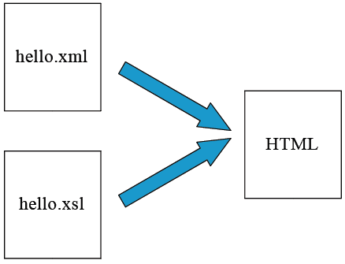
XML Transformation Example

Slide 16
Elements in XSLT - Examples
1. <xsl:template match="/">
</xsl:template>
2. <xsl:value-of select="catalog/cd/title”</xsl:value>
3. <xsl:for-each select="catalog/cd">
</xsl:for-each>
4. <xsl:sort select="artist"/>

Slide 17
...Contd
5. <xsl:if test="price &gt; 10">
<xsl:value-of select="title"/>
</xsl:if>
6. <xsl:choose>
<xsl:when test="expression">
... some output ...
</xsl:when>
<xsl:otherwise>
... some output ....
</xsl:otherwise>
</xsl:choose>

Slide 18
XSLT Stylesheet elements
Matching and selection templates
  – xsl:template
  – xsl:applytemplates
  – xsl:valueof
Branching elements
  – xsl:foreach
  – xsl:if
  – xsl:choose
Sorting element
  – xsl:sort

Slide 19
Sample cd.xml
<?xml version="1.0" encoding="ISO-8859-1"?>
<?xml-stylesheet type="text/xsl" href=“cd.xsl"?>
<catalog>
<cd>
<title>Empire Burlesque</title>
<artist>Bob Dylan</artist>
<country>USA</country>
<company>Columbia</company>
<price>10.90</price>
<year>1985</year>
</cd>
.
.
</catalog>

Slide 20
Book.xml
<?xml version="1.0" encoding="ISO-8859-1"?>
<!-- Edited by XMLSpy® -->
<store>
<book title="Computer Networks" lang="tamil">
<author>Andrew</author>
<author>Tanenbaum</author>
<price>130</price>
</book>
<book title="Web Technology" lang="en">
<author>Jeffrey</author>
<author>Jackson</author>
<price>250</price>
</book>
</store>

Slide 21
Xsl:template
An XSL style sheet consists of one or more set of rules that are called templates.
Each template contains rules to apply when a specified node is matched.
The <xsl:template> element is used to build templates.
The match attribute is used to associate a template with an XML element.
The value of the match attribute is an XPath expression.

Slide 22
Sample cd.xsl
<?xml version="1.0" encoding="ISO-8859-1"?>
<xsl:stylesheet version="1.0"
xmlns:xsl="http://www.w3.org/1999/XSL/Transform">
<xsl:template match="/">
<html>
<body>
<h2>My CD Collection</h2>
<table border="1">
<tr bgcolor="#9acd32">
<th>Title</th>
<th>Artist</th>
</tr>

Slide 23
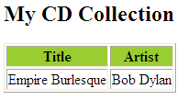
…Contd
xsl:for-each select="catalog/cd">
<tr>
<td><xsl:value-of select="title"/></td>
<td><xsl:value-of select="artist"/></td>
</tr>
</xsl:for-each>
</table>
</body>
</html>
</xsl:template>
</xsl:stylesheet>

Slide 24
<xsl:for-each>
<xsl:for-each> – allows you to do looping in XSLT.
<xsl:template match="/">
<html>
<body>
<h2>My CD Collection</h2>
<table border="1">
<tr bgcolor="#9acd32"> <th>Title</th><th>Artist</th></tr>
<xsl:for-each select="catalog/cd">
<tr>
<td><xsl:value-of select="title"/></td>
<td><xsl:value-of select="artist"/></td>
</tr>
</xsl:for-each>
</table>
</body>
</html>
</xsl:template>
</xsl:stylesheet>

Slide 25

<xsl:for-each> Predicate
<xsl:for-each select="catalog/cd[artist='Bob Dylan']">
<tr>
<td><xsl:value-of select="title"/></td>
<td><xsl:value-of select="artist"/></td>
</tr>
</xsl:for-each>

Slide 26
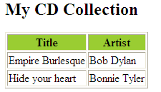
<xsl:sort>
<xsl:template match="/">
<html>
<body>
<h2>My CD Collection</h2>
<table border="1">
<tr bgcolor="#9acd32"> <th>Title</th> <th>Artist</th> </tr>
<xsl:for-each select="catalog/cd">
<xsl:sort select="artist"/>
<tr>
<td><xsl:value-of select="title"/></td>
<td><xsl:value-of select="artist"/></td>
</tr>
</xsl:for-each>
</table>
</body>
</html>
</xsl:template>
</xsl:stylesheet>

Slide 27
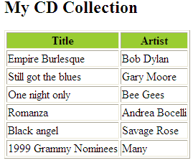
<xsl:if>
<xsl:for-each select="catalog/cd">
<xsl:if test="price &gt; 10">
<tr>
<td><xsl:value-of select="title"/></td>
<td><xsl:value-of select="artist"/></td>
</tr>
</xsl:if>
</xsl:for-each>

Slide 28
The <xsl:choose> Element
<xsl:choose> – used in conjunction with <xsl:when> and
<xsl:otherwise> to express multiple conditional tests.
<xsl:choose>
<xsl:when test="expression">
... some output ...
</xsl:when>
<xsl:otherwise>
... some output ....
</xsl:otherwise>
</xsl:choose>

Slide 29
<xsl:choose>
<xsl:for-each select="catalog/cd">
<tr>
<td><xsl:value-of select="title"/></td>
<xsl:choose>
<xsl:when test="price &gt; 10">
<td bgcolor="#ff00ff">
<xsl:value-of select="artist"/></td>
</xsl:when>
<xsl:otherwise>
<td><xsl:value-of select="artist"/></td>
</xsl:otherwise>
</xsl:choose>
</tr>
</xsl:for-each>

Slide 30
<xsl:applytemplates>
<xsl:applytemplates>
– applies a template to the current element or to the current element's child nodes.
The select attribute to <xsl:apply-templates> element, will process only the child element that matches the value of the attribute.
Use the select attribute to specify the order in which the child nodes are processed.

Slide 31
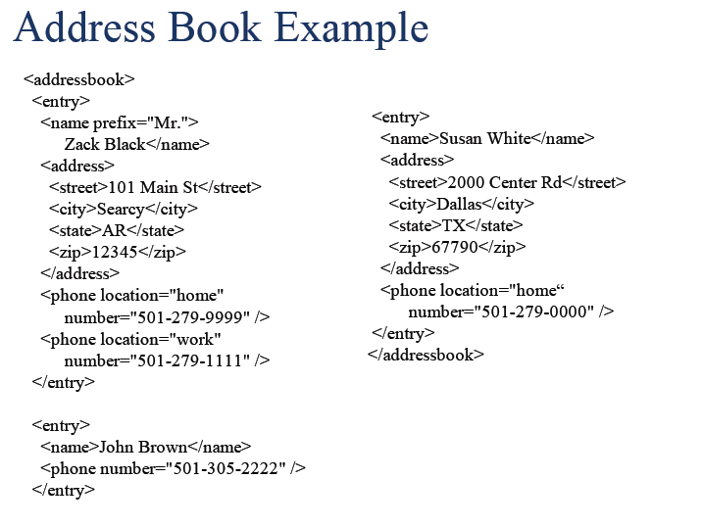

Slide 32
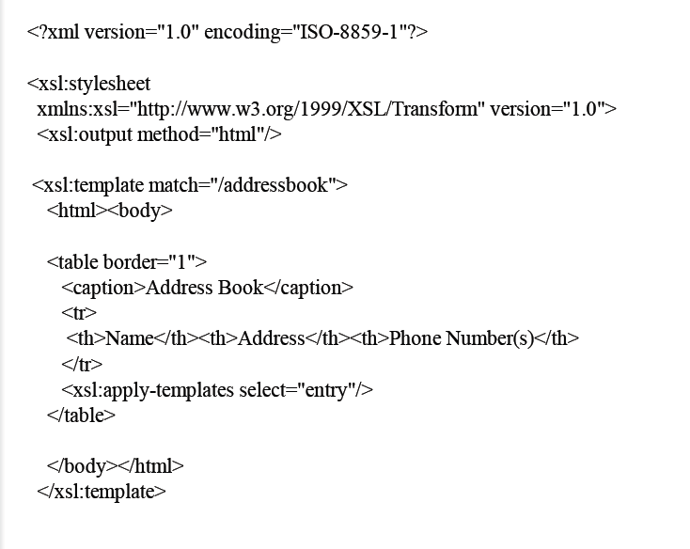

Slide 33
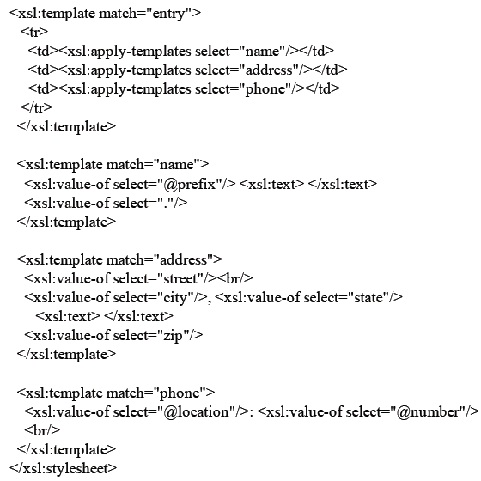

Slide 34
